Slide 1
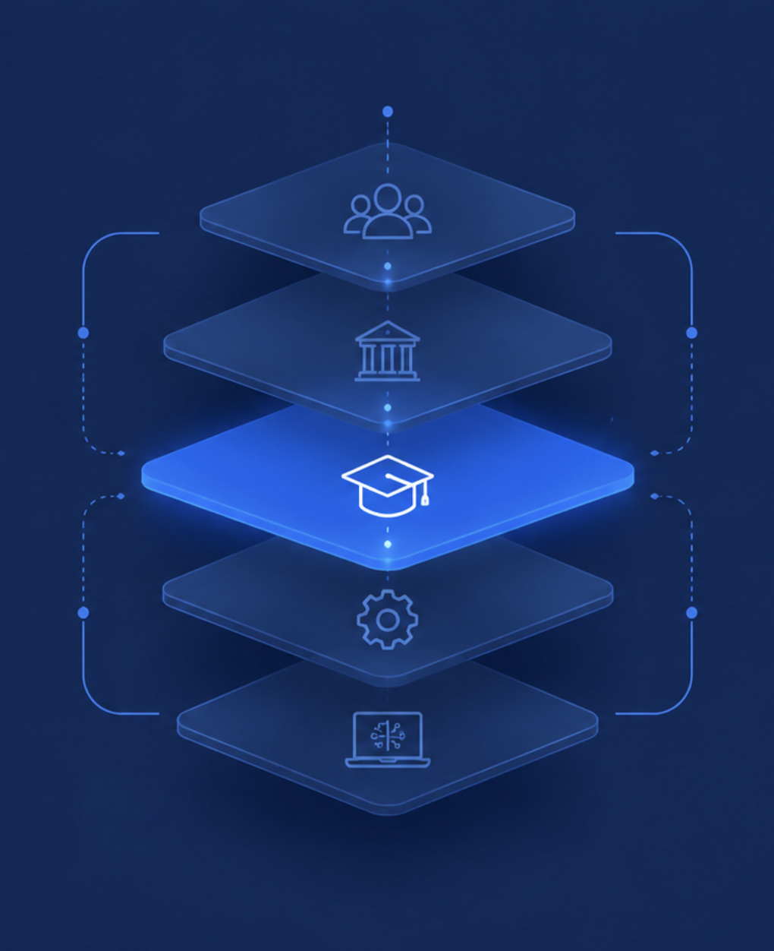

Innovation & Entrepreneurship: Undefined Problems
Curriculum as
Part of a System
Systems Analysis
Domain: Higher education | Focal point: Curriculum
Michael • Sahanna • Kerry
Skills Move Fast. Curricula Do Not.
1
Notes:
Slide 1: Cover
What this slide is doing:
- Introduces the domain: higher education, with curriculum as the focal point of the analysis.
- Frames the project as a systems question rather than a teaching-quality question.
- Signals the method: nested hierarchies and systems analysis, not trend extrapolation or scenarios.
Core idea to understand:
- Every system sits inside a larger system and contains smaller ones. Innovation fails when it happens at the wrong level.
- Our hierarchy runs Elements to Classes to Curriculum to Education to Workforce. We put our focal point on curriculum.
Why this domain matters:
- It is the system all three of us are inside right now, so we can see its elements directly.
- It is under live pressure from AI, from the entry-level job market, and from falling public confidence.
Transition:
- The next slide shows the background data: what has already changed, and at which level.

Slide 2
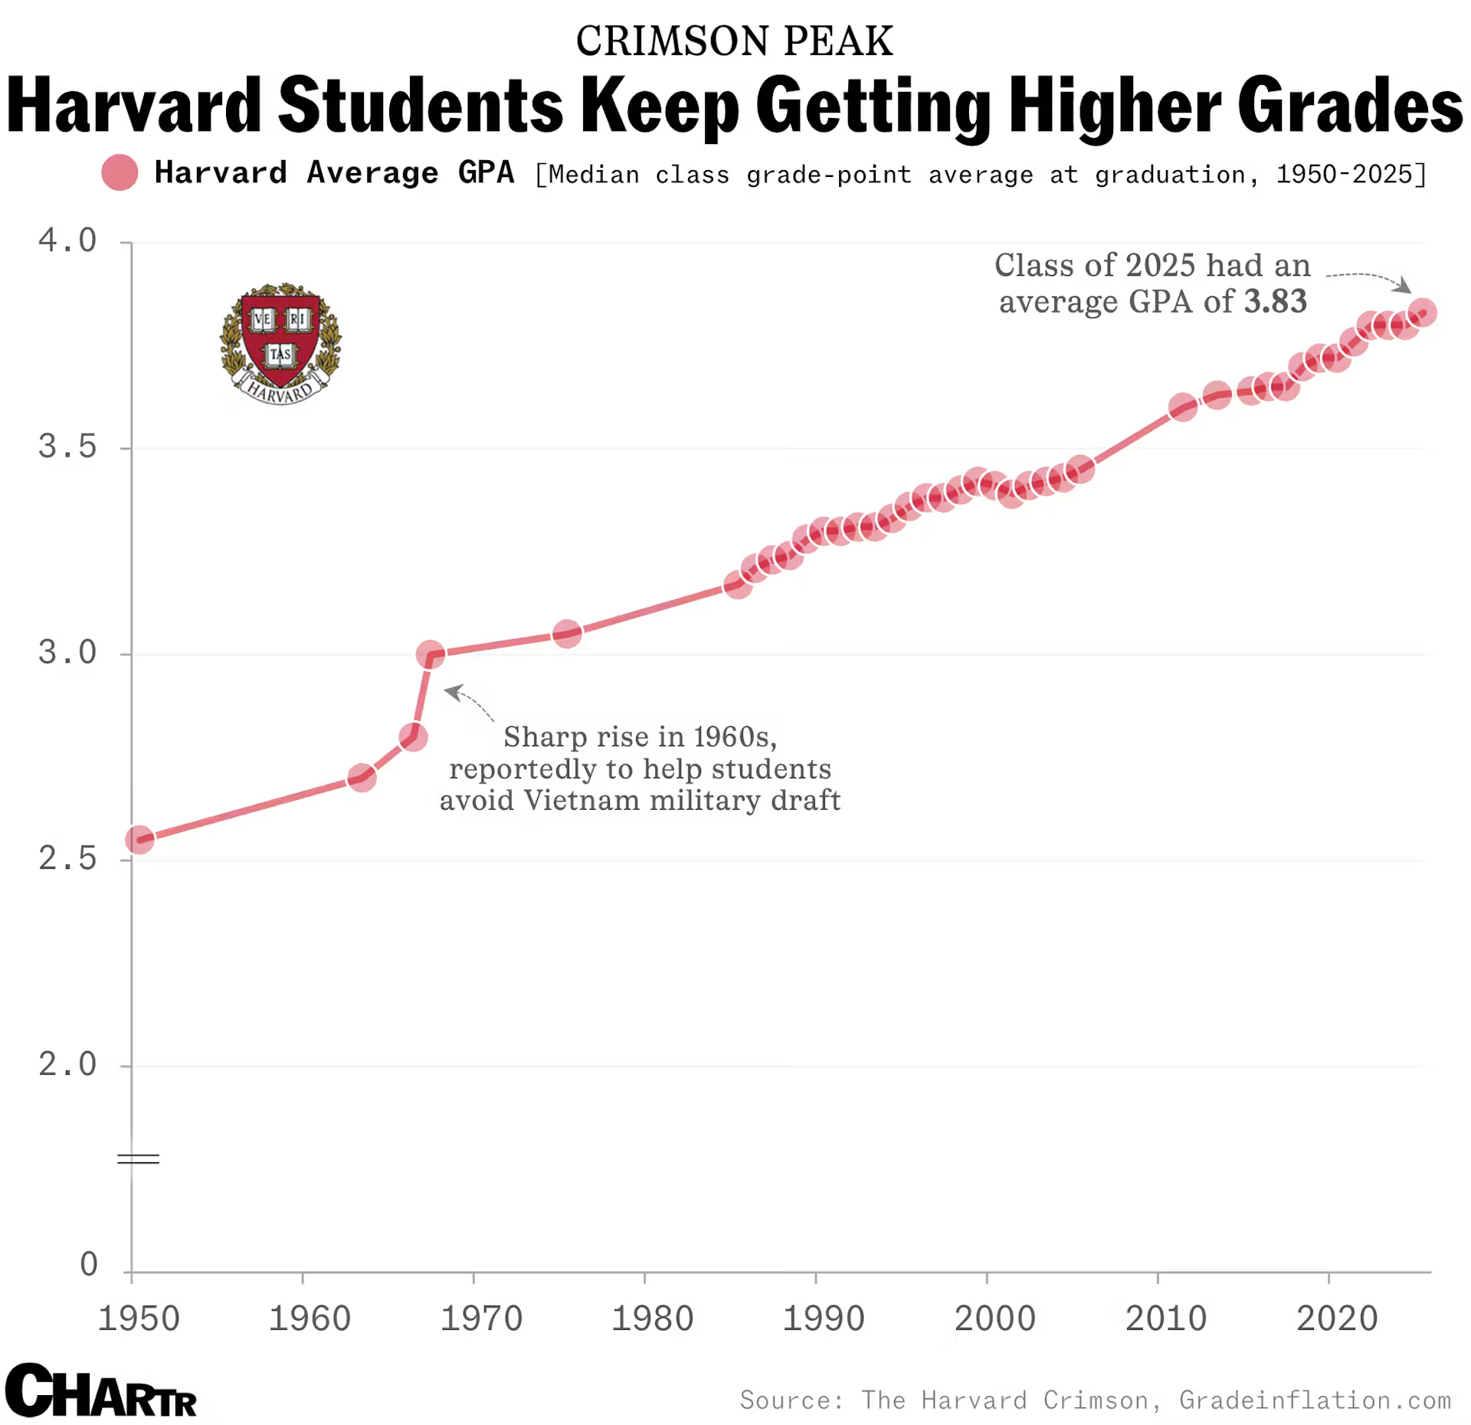





Innovation & Entrepreneurship: Undefined Problems
Domain + Relevant Data
What is a curriculum? Why is it important?
A curriculum determines how classes educate students, including learning objectives, content and subjects, teaching styles, order of material, assessments and grading, and more.
A curriculum’s elements (e.g. lectures, readings, assignments, grades, and TAs) are rapidly changing from one or both:
  teachers are adapting their curriculum for AI
  students are changing their learning habits with AI
88%
Under 30%
39%
2 years
Of students now use AI in their learning and 77% of faculty use AI to teach (in data across 35 countries).
Of students believe their assessments reflect the work and judgment an AI-enabled workplace will need.
Of workers' core skills are expected to change by 2030, with 63% of employers calling the skills gap their top barrier.
Typical time for a new program or substantive change to move from planning to an active catalog entry.
Takeaway: curriculum elements are rapidly changing and will continue to until AI matures
Sources: Digital Education Council AI in Higher Education Global Survey 2026; Harvard Office of Undergraduate Education grade report (Oct. 2025); WEF Future of Jobs Report 2025; university curriculum approval timelines (UA Little Rock; Univ. of South Carolina).
2
Notes:
Slide 2: Domain + Relevant Data
Intro to domain:
- The curriculum level decides what is taught, in what sequence, and how learning is assessed. Classes sit inside it; education and the workforce sit above it.
- Its elements are the things we listed in the worksheet: textbooks, lectures, professors, students, TAs, testing, grades, homework, projects, autograding, AI, reading, collaboration.
- The argument of this slide is that the elements moved and the level above them did not.
How to read the chart:
- The chart shows the share of Harvard undergraduate grades awarded as A's: about 25% in 2005, roughly 40% a decade ago, and more than 60% in 2024-25.
- Harvard is one institution, so treat it as an illustration of grade compression rather than a national measurement.
- The point is that the main output signal of the curriculum carries less information every year.
Why the metric cards matter:
- 88% student AI adoption and 77% faculty adoption, from a 45,000-response survey across 35 countries, shows the elements changed everywhere at once.
- Under 30% of students think assessments reflect what an AI-enabled workplace needs. The students themselves are telling us the assessment design is stale.
- 39% of core skills changing by 2030 sets the clock speed of the level above us, and 63% of employers call the skills gap their top barrier.
- Two years is the clock speed of our own level. Those two numbers next to each other are the whole problem.
Interpretation:
- This is not a story about bad teaching or lazy students. It is a mismatch of clock speeds between levels of one system.
Suggested transition:
- If the constraint is structural, we need a method that shows which level it sits on. That is systems analysis.

Slide 3



INNOVATION & ENTREPRENEURSHIP — UN-DEFINED PROBLEMS
SKILLS MOVE FAST. CURRICULA DO NOT.
Analysis: Systems Analysis
Class tool: map the hierarchy to find the level where the constraint really sits, then choose what kind of innovation to make there.
Where can innovation happen?
Curriculum as part of a system
EASIER
Workforce
Elements
AI-ready assessments, and graded practice in communication and judgment
How can individual components be made more effective?
Education
Curriculum ★
Interactions
Courses that build on each other, and proof of skill beyond a GPA
How can the components work together better?
Classes
Elements
System
Theory in 2–3 weeks, then application, with content that updates every term
What constraints limit the whole system?
Textbooks • lectures • professors • students • TAs • testing • grades • homework • projects • autograding • AI • reading • collaboration
Purpose
A degree that keeps skills current past 22 and offers what a job or AI tutor can’t
★ Focal point. Curriculum is our focal system, so the four levels on the right are the ways to innovate on it. The constraint we found sits here: the gap between what a course could be and how it is actually taught.
What if we re-imagine what the system is for?
HARDER, MORE VALUABLE
Method adapted from JHU course deck: Un-defined Problems — Systems Analysis and Nested Hierarchies; hierarchy and constraint developed by the team.
3
Notes:
Slide 3: Analysis — Systems Analysis
What method we are using:
- Nested hierarchies: every system is embedded in a larger system and contains smaller ones. Innovation often fails because the improvement is real but it happens at the wrong level.
- The method forces you to look up and down the hierarchy before deciding where to focus.
How to read the left panel:
- Our hierarchy runs Elements, Classes, Curriculum, Education, Workforce. The star marks curriculum as our focal point.
- The elements listed underneath are the ones we identified in the worksheet.
- The constraint we found is at the focal level: the gap between what a course could be and how it is actually taught, traditional grading making courses harder without making them better, and assessment that rewards memorization over exploration.
How to read the right panel:
- These are the four kinds of innovation available once a focal system is chosen. They are not a second hierarchy.
- Elements: improve a component. Interactions: improve how components work together. System: remove the constraint on the whole. Purpose: change what the system is for.
- The arrow matters. Moving down gets harder and more valuable, and most people stop at the top because that is where the work is easiest to authorize.
- The italic text on the right answers each question for our domain:
- Elements: assessments that test thinking with AI, and graded practice in communication and judgment.
- Interactions: courses that build on each other, and a record of ability employers can trust beyond GPA.
- System: 2-3 weeks of theory, then application, with content that updates faster than the two-year approval cycle.
- Purpose: a degree that keeps skills current past 22 and offers something students cannot get from a job or an AI tutor.
Main insight:
- Looking up the hierarchy changed our answer. The curriculum is where the pain shows up, but much of what holds it still is authorized one level above, in approval cycles and credit-hour rules.
- That is why the next slide spreads opportunities across all four levels instead of stacking them at the element level.

Slide 4



INNOVATION & ENTREPRENEURSHIP — UN-DEFINED PROBLEMS
SKILLS MOVE FAST. CURRICULA DO NOT.
Opportunities
AI changed work in every field. These are openings for solutions, ordered by the level they act on.
ELEMENTS
ELEMENTS
INTERACTIONS
What’s Easy to Grade Gets Taught
The Skills Nobody Assigns
The Transcript Stopped Signaling
Problem: Grading capacity sets what gets assigned. When AI arrived, schools went back to handwritten exams, and under 30% of students think assessments fit an AI workplace.
Problem: Employers see 43-point gaps in communication and critical thinking. As AI takes routine work, these skills matter more, yet no course owns them.
Problem: Over 60% of Harvard grades are now A’s, up from about 25% in 2005. Employers screening by GPA fell from 73% to 42%, and nothing has replaced it.
Opportunity: How might any major assess how students think and work with AI, at a scale instructors can grade?
Opportunity: How might judgment and communication become skills students practice and get graded on?
Opportunity: How might students show employers what they can actually do, beyond a GPA?
SYSTEM
PURPOSE
PURPOSE
Theory Without Application
A Degree That Stops at 22
Why Pay for the Degree?
Problem: Most courses spend the term on lectures and exams. 39% of core skills change by 2030, yet a curriculum change takes about two years to reach the catalog.
Problem: College teaches everything once, between 18 and 22, then stops. AI takes over entry-level tasks first, and about 70% of employers say new grads need substantial training.
Problem: Palantir now hires straight out of high school, and 7 in 10 hiring managers weigh experience over a degree. Meanwhile, AI can teach much of the content for free.
Opportunity: How might a course cover essential theory in 2–3 weeks, then spend the rest applying it to real work?
Opportunity: How might a degree keep graduates’ skills current over a career, instead of ending at graduation?
Opportunity: How might college offer value students can’t get from a job, an apprenticeship or an AI tutor?
EASIER
HARDER, BUT MORE VALUABLE
Sources: Digital Education Council 2026; WEF Future of Jobs 2025; Harvard grade report (2025); Brynjolfsson et al., Stanford (2025); Fortune (Nov. 2025); Resume Templates hiring survey (2025).
4
Notes:
Slide 4: Opportunities
What this slide is doing:
- Six opportunity spaces for solutions, not the solutions themselves. Each card states a problem and turns it into a "How might we" question.
- These apply to every major. AI has changed the work in nearly every field graduates go into.
- All six of our original opportunities are still here (Assessment That Survives AI is folded into the first card), plus a new one: why a degree is still worth paying for.
- Cards follow the innovation ladder from the analysis slide: Elements, Interactions, System, Purpose. Reading left to right, top to bottom, they get harder to act on and more valuable if solved.
Elements: What's easy to grade gets taught
- Grading capacity (TAs, autograders, multiple choice) quietly sets the ceiling on what can be assigned. With 300 students and three TAs, the assessment will be whatever can be graded at that scale, in any subject.
- AI proved it: many schools went back to proctored handwritten exams, chosen for gradeability rather than for what they measure.
- Under 30% of students think their assessments reflect what an AI-enabled workplace needs (Digital Education Council 2026). If the test rewards recall, the course teaches recall.
- Opportunity: how might any major assess how students think and work with AI, at a scale instructors can grade?
Elements: The skills nobody assigns
- Employers report 43-point gaps between how important communication and critical thinking are and how proficient graduates are. Half of educators give 20% or less of the curriculum to workforce skills.
- As AI takes over routine work, judgment and communication are what's left for people, so the gap gets more expensive.
- Opportunity: how might judgment and communication become skills students practice and get graded on, rather than byproducts?
Interactions: The transcript stopped signaling
- Harvard's A share went from about 25% in 2005 to over 60% in 2024-25. Employers responded: GPA screening fell from 73% to 42%.
- This sits on the boundary between the curriculum and the workforce. The handoff still happens; the information in it does not.
- Opportunity: how might students show employers what they can actually do, beyond a GPA?
System: Theory without application
- Most courses spend the term on lectures and exams, with application saved for a final project if there is one.
- 39% of core skills change by 2030, yet a substantive curriculum change takes about two years to reach the catalog. This is the reverse salient that holds everything else back.
- Opportunity: how might a course cover essential theory in 2-3 weeks, then spend the rest applying it to real work? For nursing that might be clinical cases, for writing a published piece, for engineering a prototype. Applied projects can also change every term without waiting for a two-year approval.
Purpose: A degree that stops at 22
- College teaches everything once, between 18 and 22, then stops. AI takes over entry-level tasks first: Stanford's Digital Economy Lab found young workers in the most AI-exposed jobs saw a 13% relative drop in employment. About 70% of employers say new grads still need substantial training.
- If the purpose shifted from issuing a qualification to maintaining a capability, terms, credits and graduation would all look different.
- Opportunity: how might a degree keep graduates' skills current over a career, instead of ending at graduation?
Purpose: Why pay for the degree?
- Employers are building their own paths around college. Palantir's Meritocracy Fellowship (2025) took 22 recent high school graduates who skipped college, chosen from over 500 applicants, with a path to full-time roles. In a 2025 survey of 1,000 hiring managers, 7 in 10 said their company weighs relevant experience over a bachelor's degree, and a quarter planned to drop degree requirements for some roles.
- At the same time, AI can teach much of the content of a course on demand, for free.
- So the degree can no longer rely on being the only way in. It has to offer something students can't get from a job, an apprenticeship or an AI tutor: maybe mentorship, real projects with experts, a network, or space to explore. Which of those is the open question.
- Opportunity: how might college offer value students can't get from a job, an apprenticeship or an AI tutor?
- This is the hardest and most valuable level: it questions what the whole system is for.
Questions any solution has to answer (say aloud, not on the slide):
- What is the minimum theory? What must come first before students can apply it?
- Where does AI fit? What should AI do, and what must students own?
- How do we know it stuck? What shows real understanding, not just a finished output?
- We are not proposing an answer. These are the tests any solution would have to pass.
Closing interpretation:
- The common thread is application and value. Across every major, the opportunity is to move from teaching students to produce answers to teaching them to apply and judge, and to make the degree worth more than the alternatives that now exist.

